Slide 2
HOW TO WIN THE HEARTS AND MINDS OF SPONSORS
PRESENTATION BY
ANDREA SZABÓ MARKETING AND PR DIRECTOR ERSTE BANK HUNGARY

Slide 3
What are the sponsors looking for?
The objectives of a sponsorship:
To create or reinforce perceptions of key brand image associations
To enhance corporate image
To express commitment to the community or on social issues
To increase salience of company or product name
To identify with a particular target market or lifestyle
To create experiences and evoke feelings for more effective communication

Slide 4
Sponsorship relations are similar to personal relationships: you have to put the effort into it to make it well-functioning
- It is not a favour from a friend
Sponsorship is not an occasional agreement. It is an integrated part of the sponsor’s long term marketing strategy. Moreover it is continuously collaborating with the marketing strategy and the corporate image.
- Paying attention to the own values
The sponsorship activity is always strict to the values and image of the company. The sponsored team is always chosen carefully, because the team makes the brand alive.
- It is more than advertising
Sponsoration is a sophisticated marketing opportunity to reach the target segment, to generate brand loyalty and attract new potentional customers. Due to the unique environment that sponsorship activity creates, the message transfer to the customers is really effective and special.
- There is always a sponsorship strategy with the proper information
You can always find a sponsoration strategy that contains the fundamentals: which area does the sponsor support (sport, education, culture, healthcare), the way of supporting (only one person, team, institution), and how do they take social responsibilites.

Slide 5
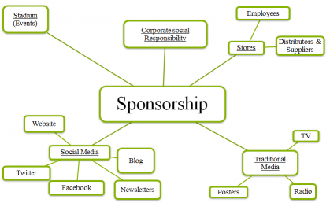
Sponsors need an activation map:
Sponsors can use your platform to reach several target audiences through different channels :
Own employees
VIP partners
Prospect business partners
Your other sponsors
Your fans
New potential clients

Slide 6
What causes headches for sponsors?
Potential risks of sponsorship
If the chosen team does not bring the expected results in the exact field of sport it can have a negative effect on the sponsor company’s brand image (in terms of associations), that might leads to loosing customers or brand recognition
Supporting a team means dividing the financial resources into more parts and allocate it for different areas. As a result, some parts might have a detriment
Sensitivity in terms of public opinion and social-political environment
Sensitivity toward the behaviour of the team and also individuals

Slide 7
What do the sponsor expect form their partner?
The candidate should always be up to date with the important datas in the exact sport. (the popularity of the sport, the number of people that can be reached via TV, or live streaming, the number of people who follow the sport regularly)
The candidate should not have an already existing sponsorship agreement in the same segment while searching for a new sponsor
The brand image of the sponsor company always have to be kept in mind
The sponsoration activity always have to be measured continuously and have to be compared with the datas before the actions.
The candidate always have to cooperate with the sponsor and make plans or decisions together
The candidate should designate an official person who is in charge of the relationship between the partners

Slide 8
You have a great „product” at your hands!!!
MAGYAR JÉGKORONG SZÖVETSÉG
• A women team in ice hockey is really special, a great asset in nowadays. The women team perfectly shows that they manage to do this sport, despite it is a tough and hard sport with lots of contact and collision between the players in the field.
• A sponsor company can attract many positive association if it supports a team of young players.
• Our world is full of changes, aspirations and movements. The concept of a women hockey team is unique, inspiring, and it has a huge actuality in terms of the current changes of the world. It can attract the attention of bigger companies as well.
• The role of social media is extremely increasing. It gives the possibilty to users to express themselfs effectively. Using this tendency can be a good opportunity for making the team more and more popular on the internet. Many people can see the posts, live streaming of the matches, and they also can share or tell the contents to friends.
• It is getting more popular for sponsors to stand next to gender equality and to cooparte with women teams in sports. Many famous brand built up sponsorship relations with women team or individuals. Also many famous clubs has a women team besides the men team.
„The faith to move mountains begins with the patience to sift sand.”

Slide 9
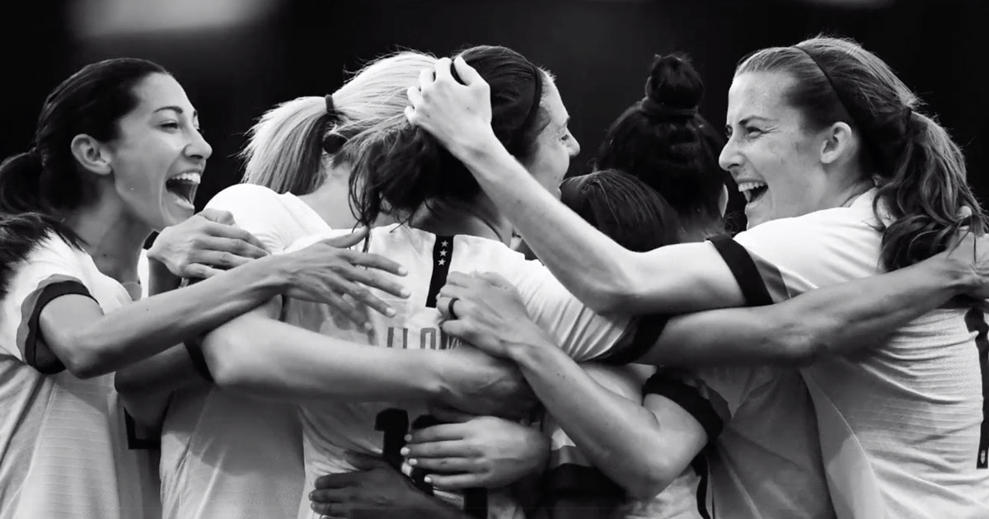
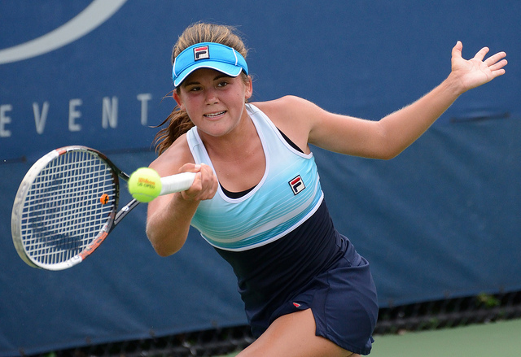
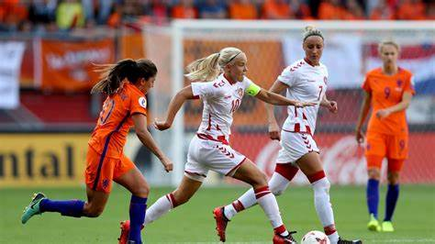
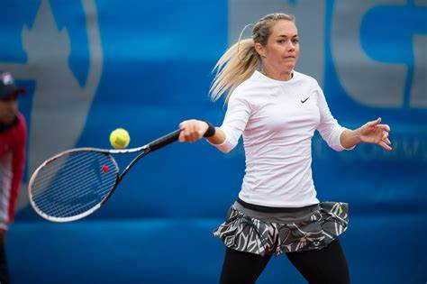
Some example:
Women’s World Cup championship against the Netherlands on Sunday and know that the US team won 2-0 in a nail-biting game.
Nike released an ad hours later showing highlights of the tournament and reminding the world that women’s rights are everyone’s rights.
Famous brands like Nike, Adidas, Budweiser and Lucozade Sport all showed support for a gender-equal sporting future by supporting the FIFA Women’s World Cup in France.
The top 30 women tennis player also haves big brands as a sponsor ( Nike, Adidas and Fila, Lacoste, Asics, New Balance, Lotto)

Slide 10
Your value is in the young women,
who believe in what you do and work hard for achiving their goals

Slide 11
THANK YOU!

